Slide 1
World Bank – Technical Assessment 2025
Gabriel Soto
Gas102@georgetown.edu
https://github.com/gasoto04/

Slide 2
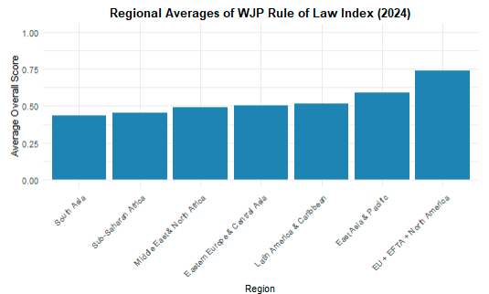

Slide 3
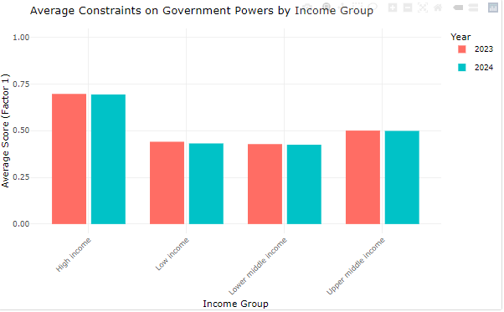

Slide 4
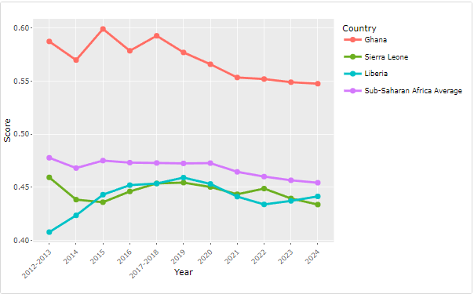

Slide 5
Analysis
From the onset, we can see a strong relationship between the WJP Rule of Law Index on the Corruption Perception index CPI. With everything else holding constant, an increase of 1 on the Rule of Law Index, would result in a 1.17 increase points in CPI.
It is worth mentioning that, through interactions we can see how the Rule of Law Index differs per region. From the model we can conclude that some regions will see a greater impact on their CPI, compared to Sub-Saharan Africa (Middle East and North Africa).
Meanwhile other countries see a decrease on their CPI. This could be related to bias related to, how much of an impact would better rule of law would impact in Africa, contrary to Europe, where institutions are more established.

